Slide 1
Arduino Workshop
Hosted by CWI Computer Science And Math Club

Slide 2
Get a TinkerCAD Account
Go to tinkercad.com
01
Set up an account
02
Go to circuits
03
Call one of the officers over if you require assistance

Slide 3
What is Arduino?
Open source hardware
Microcontroller
Easy to implement
Platform for fast prototyping

Slide 4
Open source?
Open source means that the source is available for anyone to see, change, and build. In the case of Arduino, it has been released under the GNU public license / GNU lesser public license.
Open source allows for rapid feedback and free improvements to the software. Many things are Free and Open Source Software (FOSS) and Free and Open Source Hardware (FOSH).
Some examples of each are Linux (FOSS) RIP-RAP 3D printers (FOSH) and Arduino (FOSS & FOSH)

Slide 5
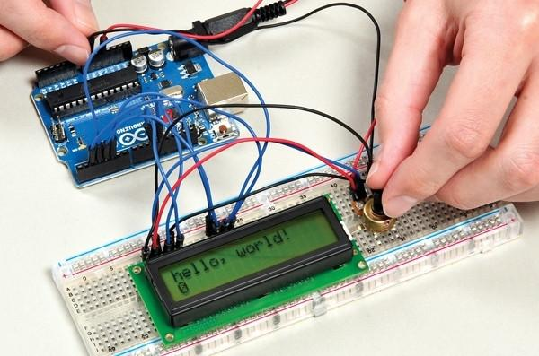
Arduino, Interface between programming and hardware
Because it is open source, many programming libraries have been made available to make complicated tasks easy, such as writing on an LCD screen.
Because of this Arduino is widely used in everything from mechatronics to art.

Slide 6
What will this workshop cover?
Downloading and installing the Arduino IDE
Running Blink on an Arduino
How breadboards work
A simple LED circuit with some input buttons and a piezo
Time permitting, we will also cover some more advanced sensors and servos

Slide 7
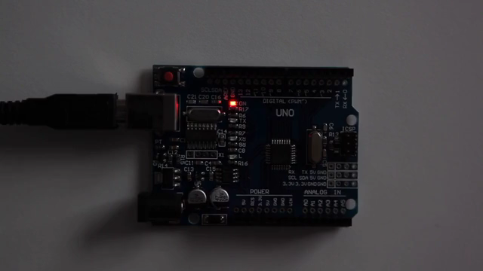
Running Blink on an Arduino

Slide 8
Basics of Arduino Programming
Void setup(){}
Void loop(){}

Slide 9
Void setup(){}
This block only runs once
Used to set up pins as input or output
Also used to initialize objects

Slide 10
Void loop
Runs on repeat until the Arduino is unplugged
This is the main body of the code

Slide 11
Example code
void setup(){
pinMode(LED_PIN, OUTPUT);
}
void loop(){
digitalWrite(LED_PIN, HIGH);
delay(1000);
digitalWrite(LED_PIN, LOW);
delay(1000);
}

Slide 12
Some basics
If statements
If using a sensor such as a button, use digitalRead(). Returns HIGH or LOW.
Loops
While loop, loops until run condition becomes false.
For loop, loops until an incrementer reaches a set value.

Slide 13
Stop light project
Look up madson812 on tinkercad and navigate to his circuits. Click on the stop light, no code circuit and select tinker this.

Slide 14
Serial line
Set the baud rate in the setup, Serial.begin(baudRate);
To read a variable, use Serial.print(var); or Serial.println(var);

Slide 15
Serial uses
The Serial monitor gives us a great way to see what’s wrong with the project when it’s not working the way we want it to.
This is a great way to debug your programs since there isn’t a debug tool provided and Arduino doesn’t have enough memory to store lots of code.

Slide 16

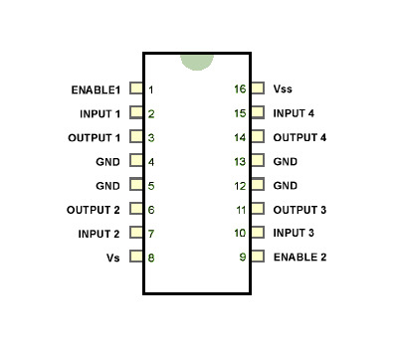
H-Bridge

Slide 17
Some more commands
analogRead();
Allows reading of values between 0 and 1024 from analog pins
analogWrite();
Allows writing through pwm of values between 0 and 255
Map(input, initialLowerBound, initialUpperBound, endLowerBound, endUpperBound);
Maps values from one set to another. Example use would be mapping from 0-1024 to 0-255

Slide 18
Motor project
Go to madson812 on tinkercad, click on motor circuit, no code and select tinker this
There are two options for this project:
Turn the motor turns clockwise, counter clockwise, and then turn it off
Control the motor speed using the potentiometer
Make sure to enable the motor or else it won’t spin

Slide 19
Computer Science and Math club Arduino Project

